Slide 1
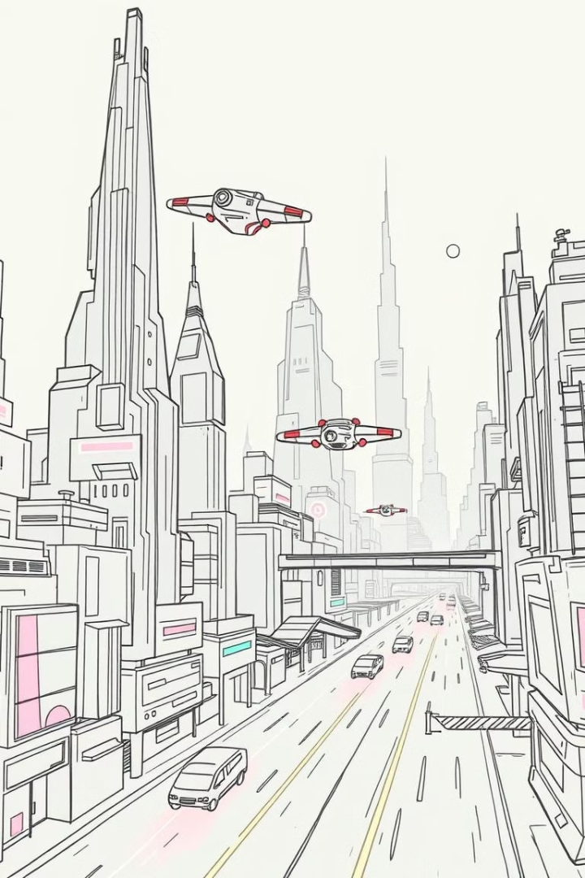

AI-Driven Pathfinding & Multi-Agent Navigation in Unity
A* Algorithm, Ant Colony Optimization, and Multi-Agent Systems
by Karan Sah

Slide 2

Introduction to AI Navigation
Project objectives: AI-based navigation in Unity.
Dynamic Environments
Optimized Paths
Enable realistic agent behavior
Efficient movement through levels
Intelligent Agents
React and adapt to changes

Slide 3
A* Pathfinding and Heuristics
G-Cost
H-Cost
F-Cost
Cost from start to current node
Estimated cost to the goal
Total cost (G + H)
Euclidean heuristics for optimized search.

Slide 4




Multi-Agent Navigation
Load-Based Speed
Adjust speed based on weight
Collision Avoidance
Prevent crashes between agents
Collaborative Movement
Agents work together

Slide 5
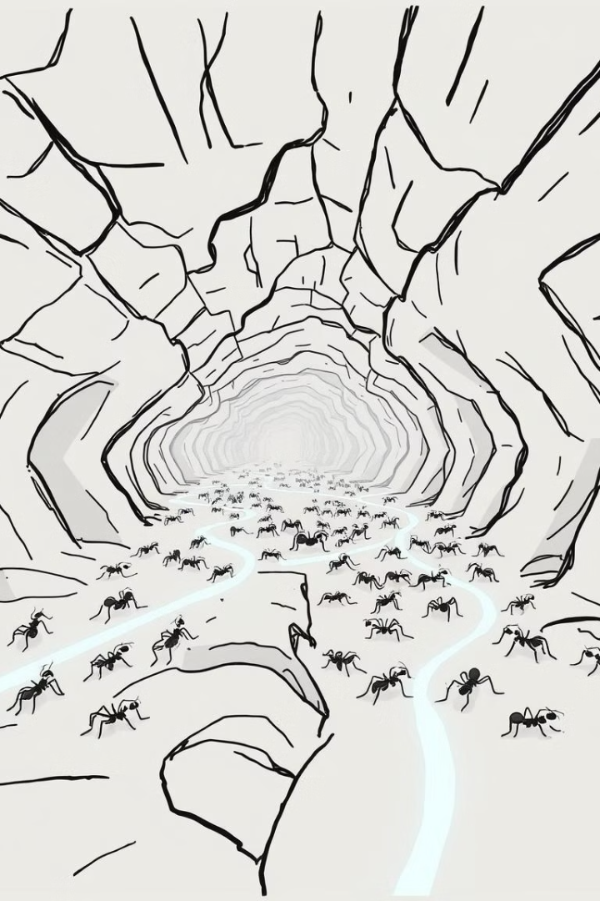



Hybrid Navigation: ACO & A*
ACO
A*
Efficiency
Optimize multi-goal deliveries
Efficient return trip
ACO vs A* efficiency comparison

Slide 6



Assets Used
EasyRoad3D
Polygon City
Simple Poly City

Slide 7
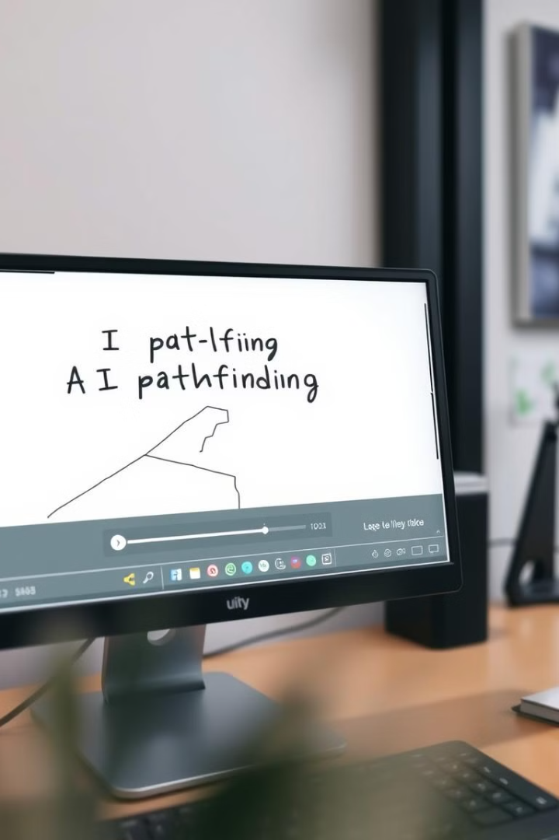
Demo Video Links
1
Part 1: A* Pathfinding
Demo of single agent pathfinding:
https://drive.google.com/file/d/1URHps67z2YXPWjpFqY5IzIJv_WtapZD7/view?usp=sharing
2
Part 2: Multi-Agent Navigation
Demonstration of collaborative movement:
https://drive.google.com/file/d/1Jlr0DjPCIwfTy_jgxEpP_egadTvFnfBs/view?usp=sharing
3
Part 3: Hybrid ACO & A*
Combining ACO and A* for optimal results:
https://drive.google.com/file/d/1ta7oAxM_0NS5cgSzGdb3818rS4pRdo90/view?
usp=sharing

Slide 8

Conclusion & Applications
Key learnings from A*, ACO, multi-agent, and hybrid navigation.
1
Logistics
Optimized delivery routes
2
Robotics
Efficient robot navigation
3
Autonomous Vehicles
Path planning and collision avoidance
Thank you!

